Slide 1

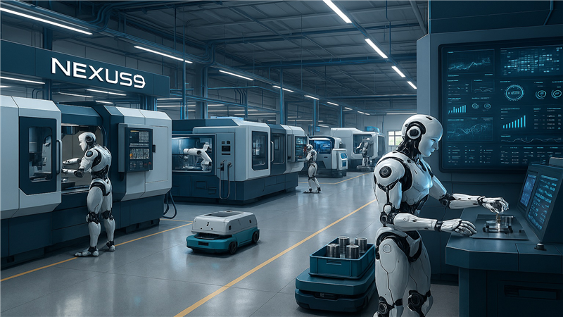
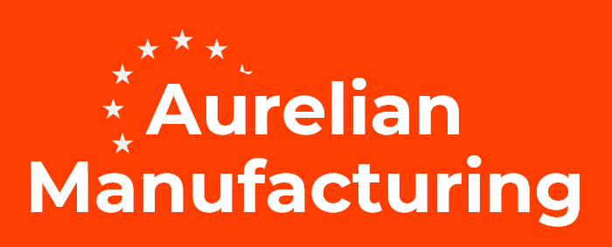

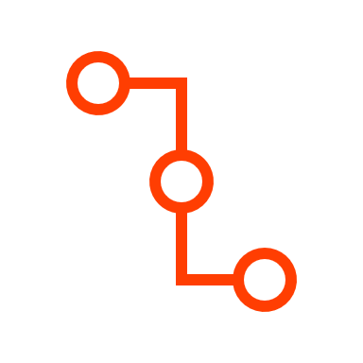



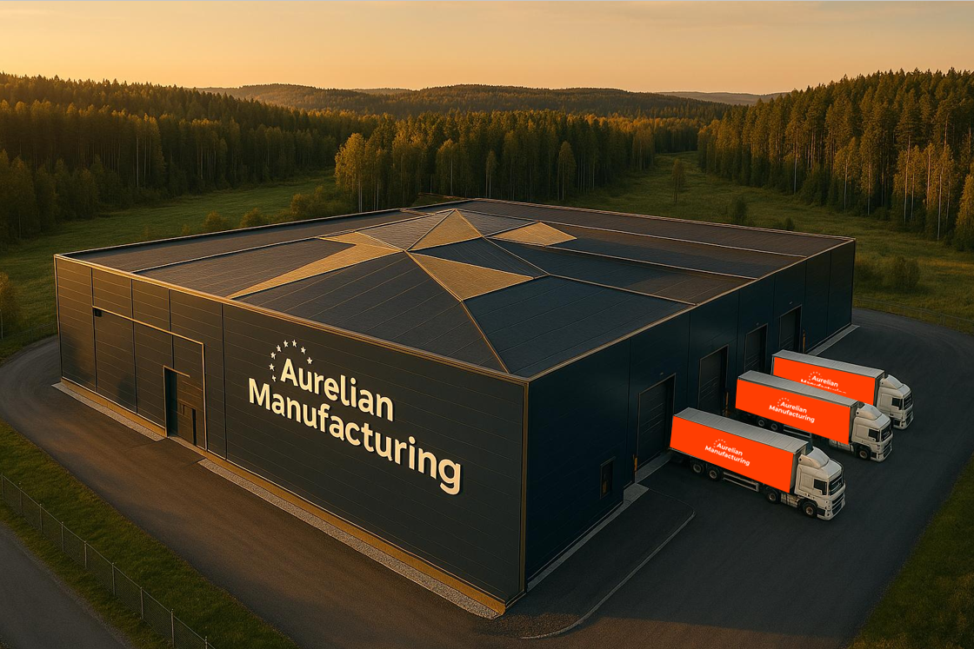
PROJECT:
NEXUS_9
The Idea
High-precision manufacturing, exclusively made-to-order machined components.
Supply Chain Sovereignty Reduce critical dependency on distant manufacturing hubs by establishing resilient, automated production capabilities
Regional Economic Transformation - Create a high-value manufacturing ecosystem that attracts global tech talent, R&D investments, and advanced manufacturing companies
Future-Proofing Industrial Competitiveness - Capture first-mover advantage in the inevitable shift toward fully autonomous manufacturing, securing Østfold’s position as a leader in advanced production technologies
Human-Level Physical Intelligence – Applying humanoid robots with advanced tactile sensing, computer vision, and adaptive manipulation capabilities represent the missing link for achieving true lights-out manufacturing, enabling complex assembly tasks, quality inspections, and exception scenarios that currently require human workers.
High precision
“Lights Off Manufacturing”
Speed: Game changing production velocities
that redefines manufacturing timelines.
Supply Chain Resilience: Eliminate global supply chain vulnerabilities
through on-demand local production of critical components.
Flexibility: Customer-controlled manufacturing agility that adjusts specifications, schedules and cost in real-time.
Cost Efficiency:Redefine manufacturing economics with automated precision that makes premium quality affordable for every project.
Quality Assurance/Control: Achieve the highest international standards for offshore, aerospace, and defense industries through automated precision that eliminates human error.
Strategic Partnership & Scale Opportunity - Establishing Aurelian Manufacturing creates a unique symbiotic relationship with Physical Robotics AS as their primary development and deployment partner for physical intelligent humanoid robots, while simultaneously capturing the component manufacturing opportunity for 100,000+ humanoid robots by 2035, positioning Østfold and Norway to both pioneer and produce the physical intelligence systems that will define next-generation autonomous robotics and manufacturing facilities globally.
Scalable Deployment & Regional Innovation Impact - The project will generate cascading opportunities to deploy proven humanoid robotics solutions across diverse manufacturing sectors, process industries, food processing facilities, and circular economy applications, leveraging the trained robotic systems and operational expertise developed at Aurelian. These efficiency-driven spin-offs will amplify the transformative impact of Østfold's Regional Innovation Valley initiative, creating a multiplier effect that extends autonomous manufacturing capabilities throughout the regional industrial ecosystem.

Slide 2
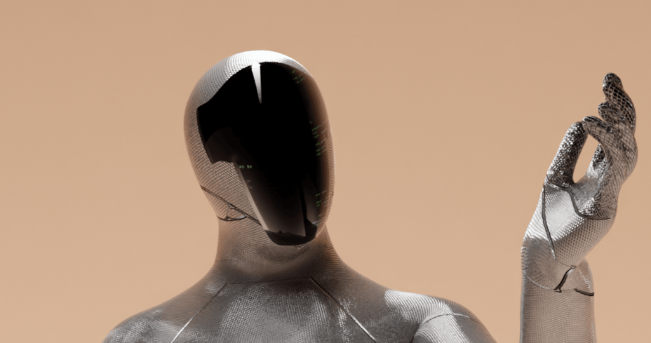
PROJECT:
NEXUS_9
Industrial Symbiosis
Positioning the Østfold region as a hub for advanced manufacturing and industrial symbiosis, with a strong emphasis on digital transition and circular economy, to drive regional growth. By fostering collaboration between machining, welding, and metal 3D printing companies and prioritizing education and skills development, the region can build a solid foundation for sustainable growth, innovation, and long-term competitiveness.
Examples of Symbioses
Competence Symbiosis for Advanced Manufacturing
Digital Twin Network for Production Optimization
Production Network with AI Coordination and Capacity-Based Task Sharing
Data-Driven Quality Network
Enabling Full “Lights-Off” Manufacturing through Intelligent Physical Humanoid Robots
100% Traceability of Residual Materials through Digital Material Passports and a National Materials Exchange
NECIA Tech Cluster
Other stakeholders
7Waves
Disruptive Engineering
Krescado
Incrementi
Ezone Energy
Energy AI
Aker Solutions
BEWI
CodeIT
Dynatec Engineering
Gundersen & Løke AS
MHTech
MNU
Norsk Elektro Optikk AS
Physical Robotics AS
Pronofa
Servi Group
Sew Eurodrive
Skolt
Slåttland
StepSolutions
Techni
Tronrud Engineering
Vulkan Engineering
Wärtsilä
Zebra
Zephyr
Environments and companies that will benefit from this project
Regional industry clusters.
Technology providers with expertise in sensor technology and data analysis
All mechanical companies in Østfold
Høgskolen i Østfold
Fagskolen Viken
Industrifagskolen
Upper secondary schools offering technology and industrial subjects
Municipalities and the county authority
Technology providers with AI expertise
Universities and strong national and international academic communities connected to the region
MNU/ITS enywere
Enablers: Regional Clusters and their members.

